Slide 1

Bank Customer Churn analysis
Presented By :
Pruthvi. M , Mounik. V , Raj P

Slide 2
Introduction
Bank Customer Churn analysis is a process of analyzing customer data to identify factors that contribute to customer churn, i.e, customers who close their accounts and stop doing business with the bank. The goal of Bank Customer Churn analysis is to analyze historical data and identify all the factors for Churn which may impact bank’s revenue. Moreover, we can also develop predictive models that can be used to identify at-risk customers and take proactive steps to retain them.

Slide 3

Problem Definition
For banks, customer churn is a big problem because it results in lower income and higher customer acquisition expenses. Finding the main causes of customer churn and creating strategies to stop it are the goals of a bank customer churn study.
A typical problem statement for a bank customer churn analysis entails looking at past customer behavior and demographic data to create a predictive model that can precisely spot customers who are at risk of leaving the bank. Banks can take targeted action to keep valued customers and lower the general rate of churn by pinpointing the causes of customer churn.
It is common practice to look for patterns and trends that can help forecast customer churn when conducting a bank customer churn analysis using data such as credit score, salary, product usage, age, and demographics. It is possible to pinpoint elements that can add to churn by analyzing this data, such as customer dissatisfaction with goods or services.

Slide 4

Problem Definition
Once the main causes of customer churn have been discovered, banks can create strategies to stop it. Offering incentives to keep customers, enhancing customer service, or modifying product features or pricing are some examples of these tactics. Metrics like revenue growth and customer retention rates can be used to assess how successful these strategies are.
The main objective of a bank customer churn analysis is to keep valued customers and lower the rate of customer churn. Banks can boost revenue and boost customer happiness by identifying the churn-causing factors and creating strong retention strategies.

Slide 5
Dataset
The Bank Customers Churn dataset is a collection of data on bank clients and whether they have churned, that is, ended their accounts and ceased doing business with the bank. The dataset contains a variety of demographic, monetary, and transactional data regarding each client.
Typically, this dataset contains statistics like demographics of the client, including age, gender, tenure, user usage, country, Account balances, credit score, other financial data.
I have fetched this data set from open-source portal called `Kaggle`. It is a structured data having 13 columns and 10000 rows inside it which includes features like Name, customer id, Credit score, bank balance, salary, credit cards, active status, country, gender.

Slide 6
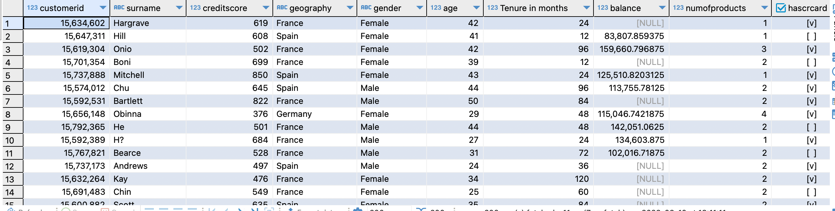
Sample Data

Slide 7
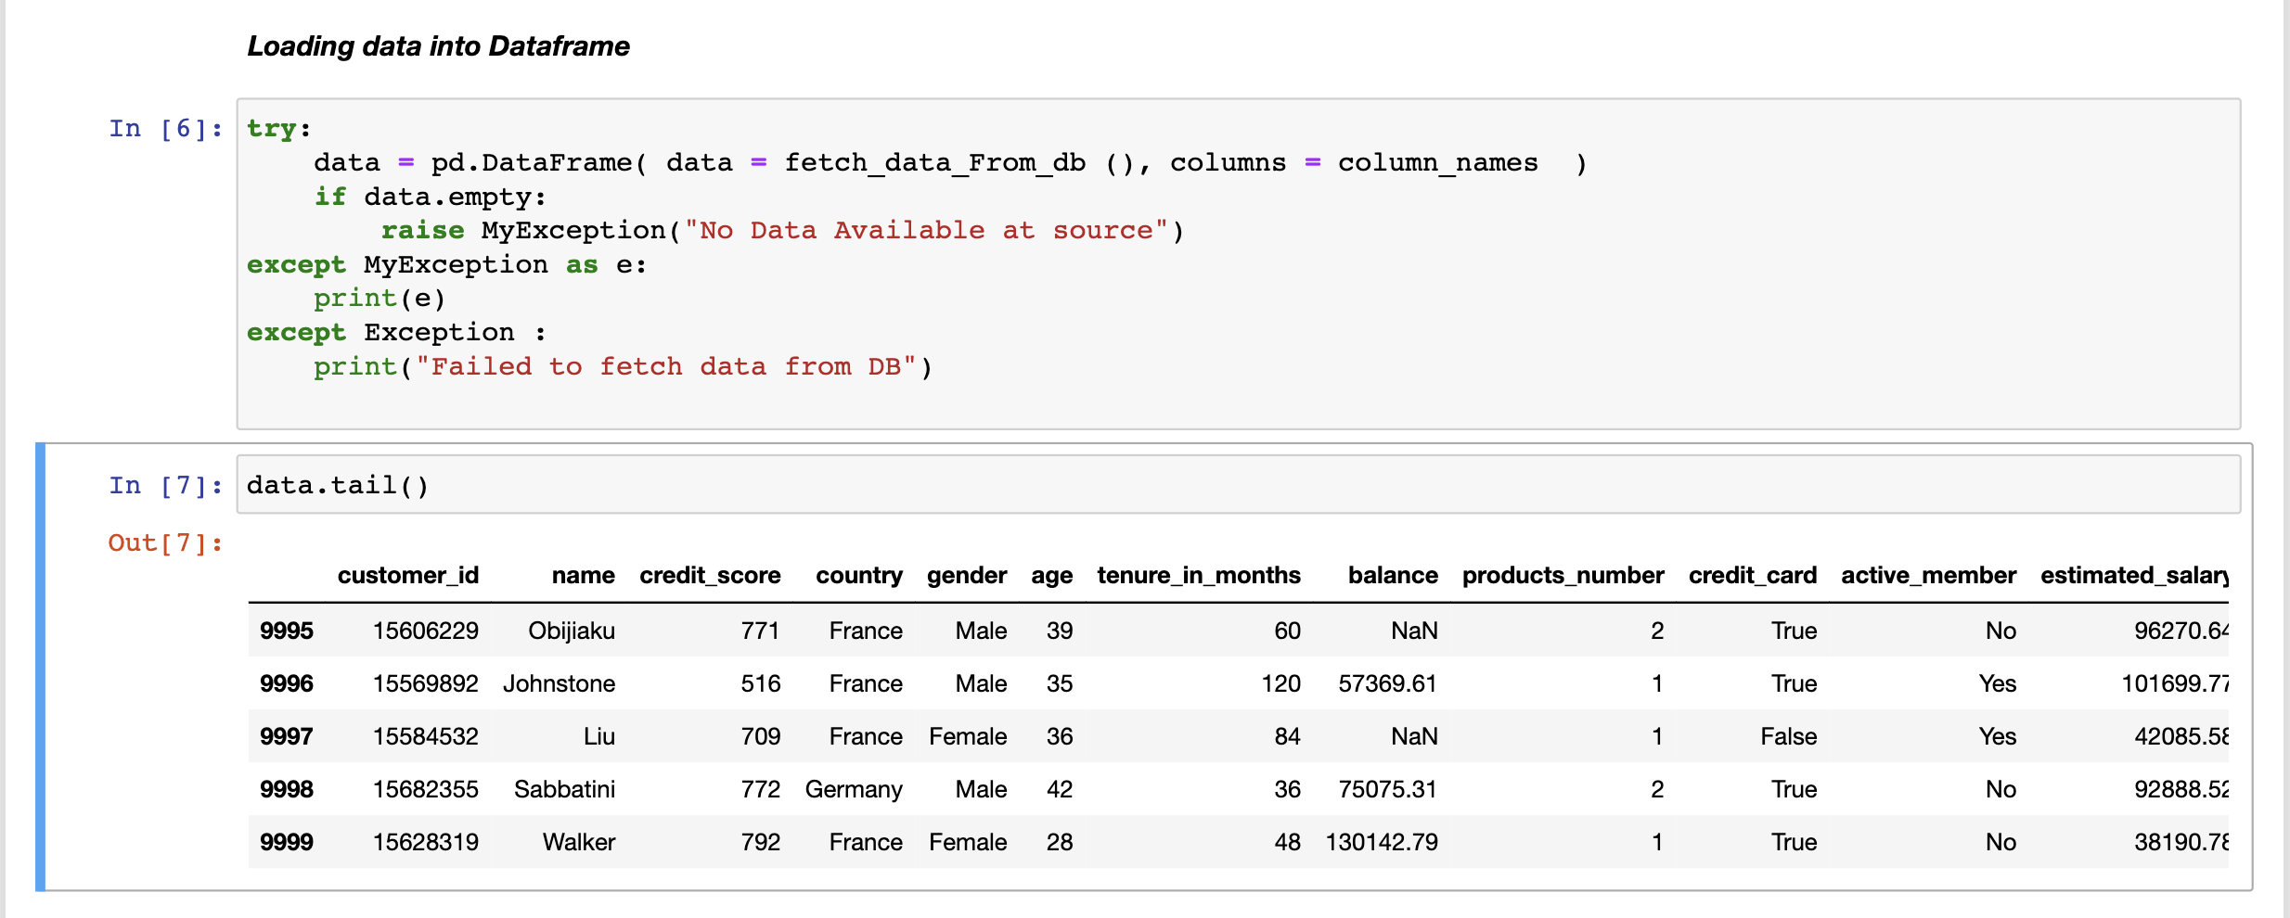
Loading Data
Loading data from postgreSQL to Pandas Data Frame

Slide 8
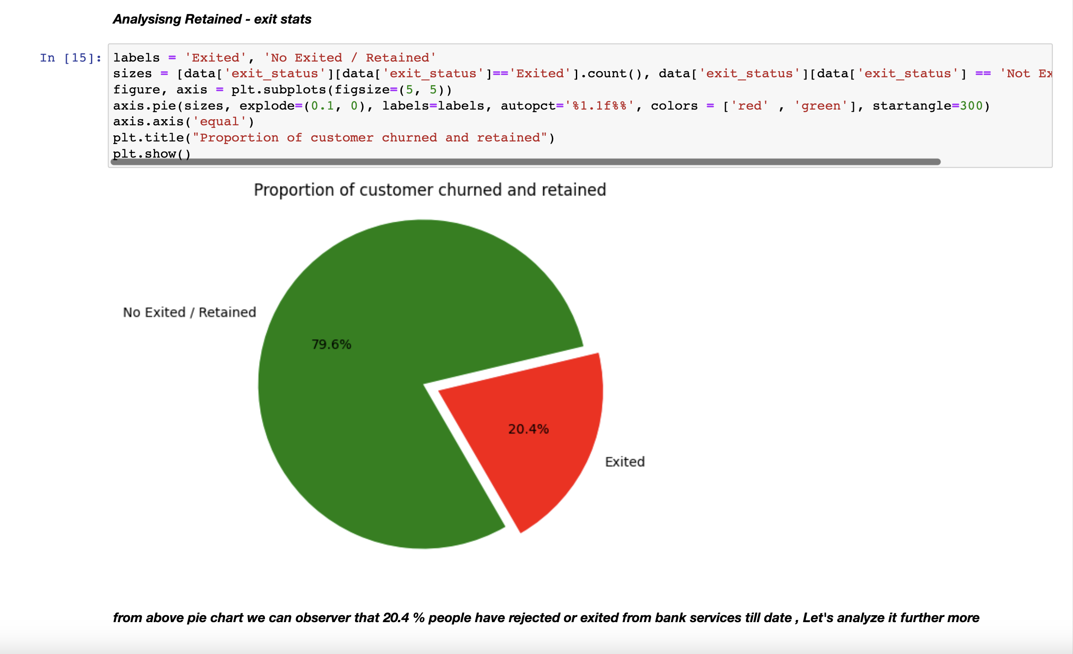
Analyzing Churn Data

Slide 9
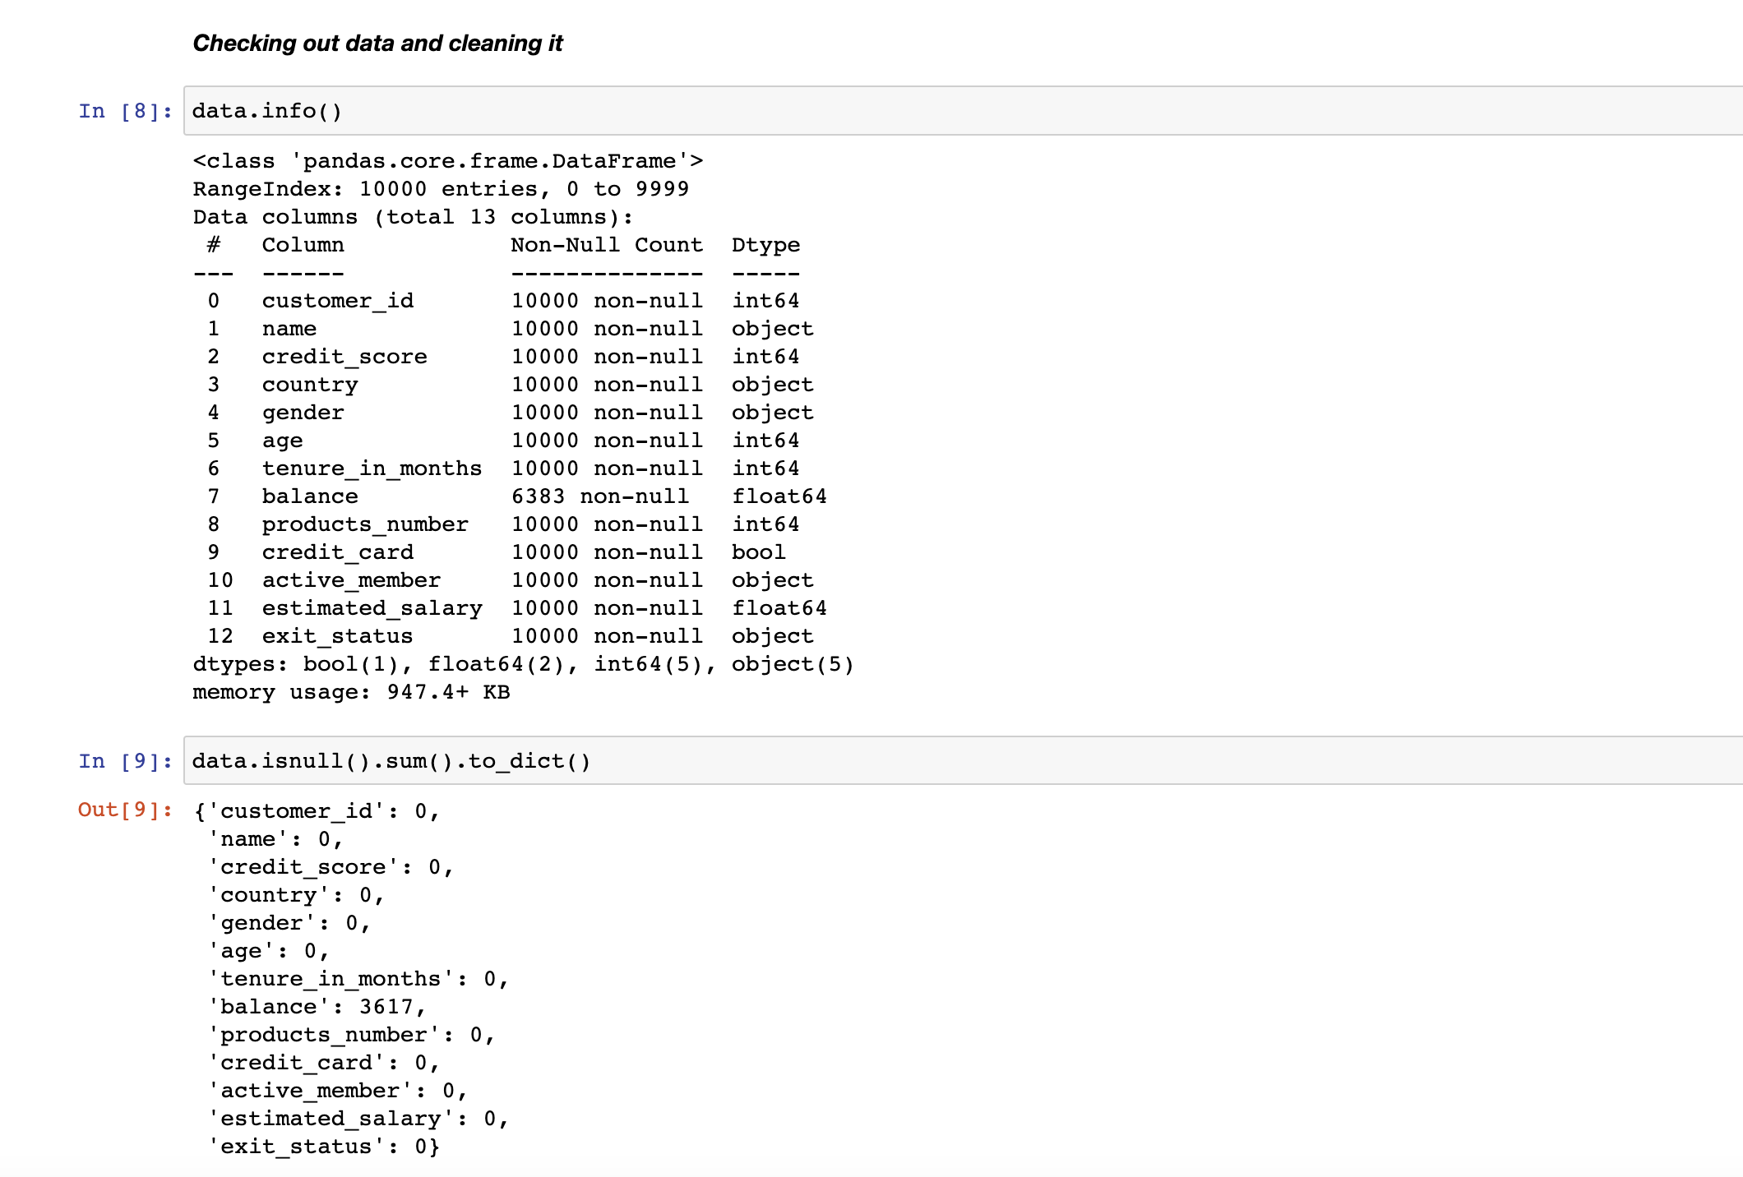
Reviewing Data frame and Checking for Null values

Slide 10
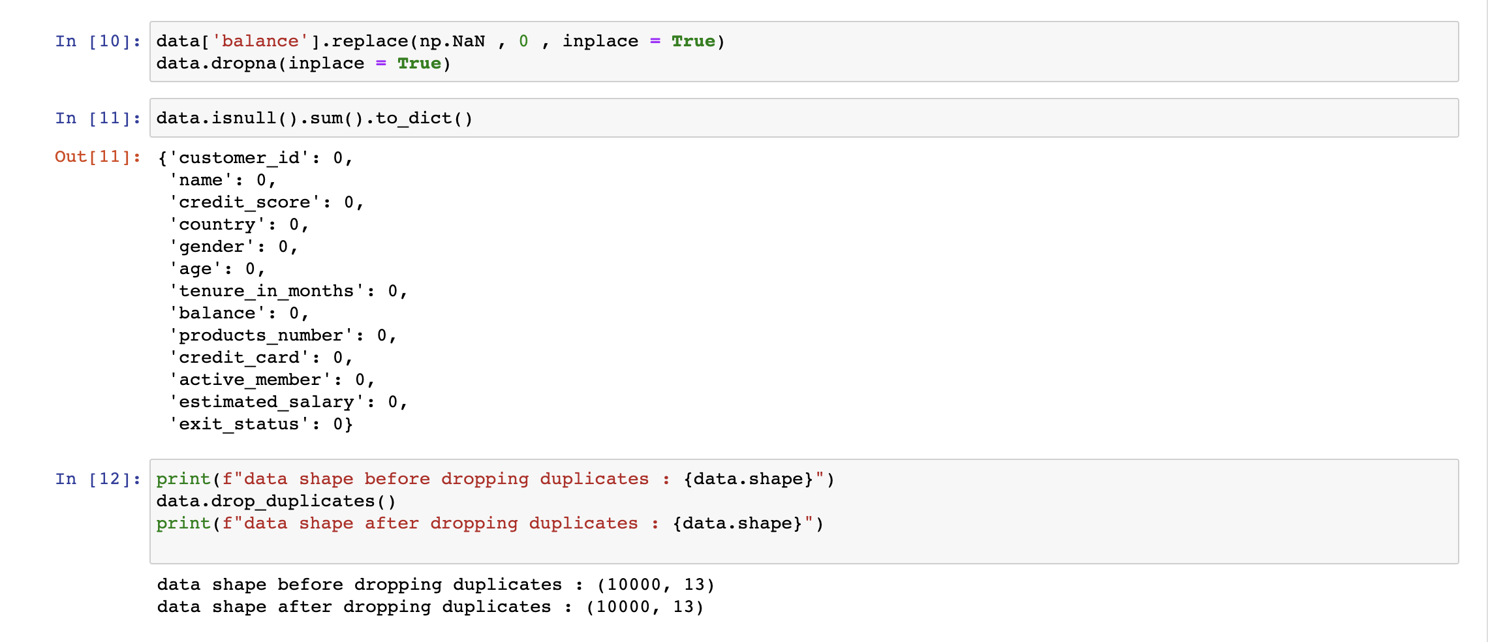
Replacing Null values and dropping Duplicates

Slide 11
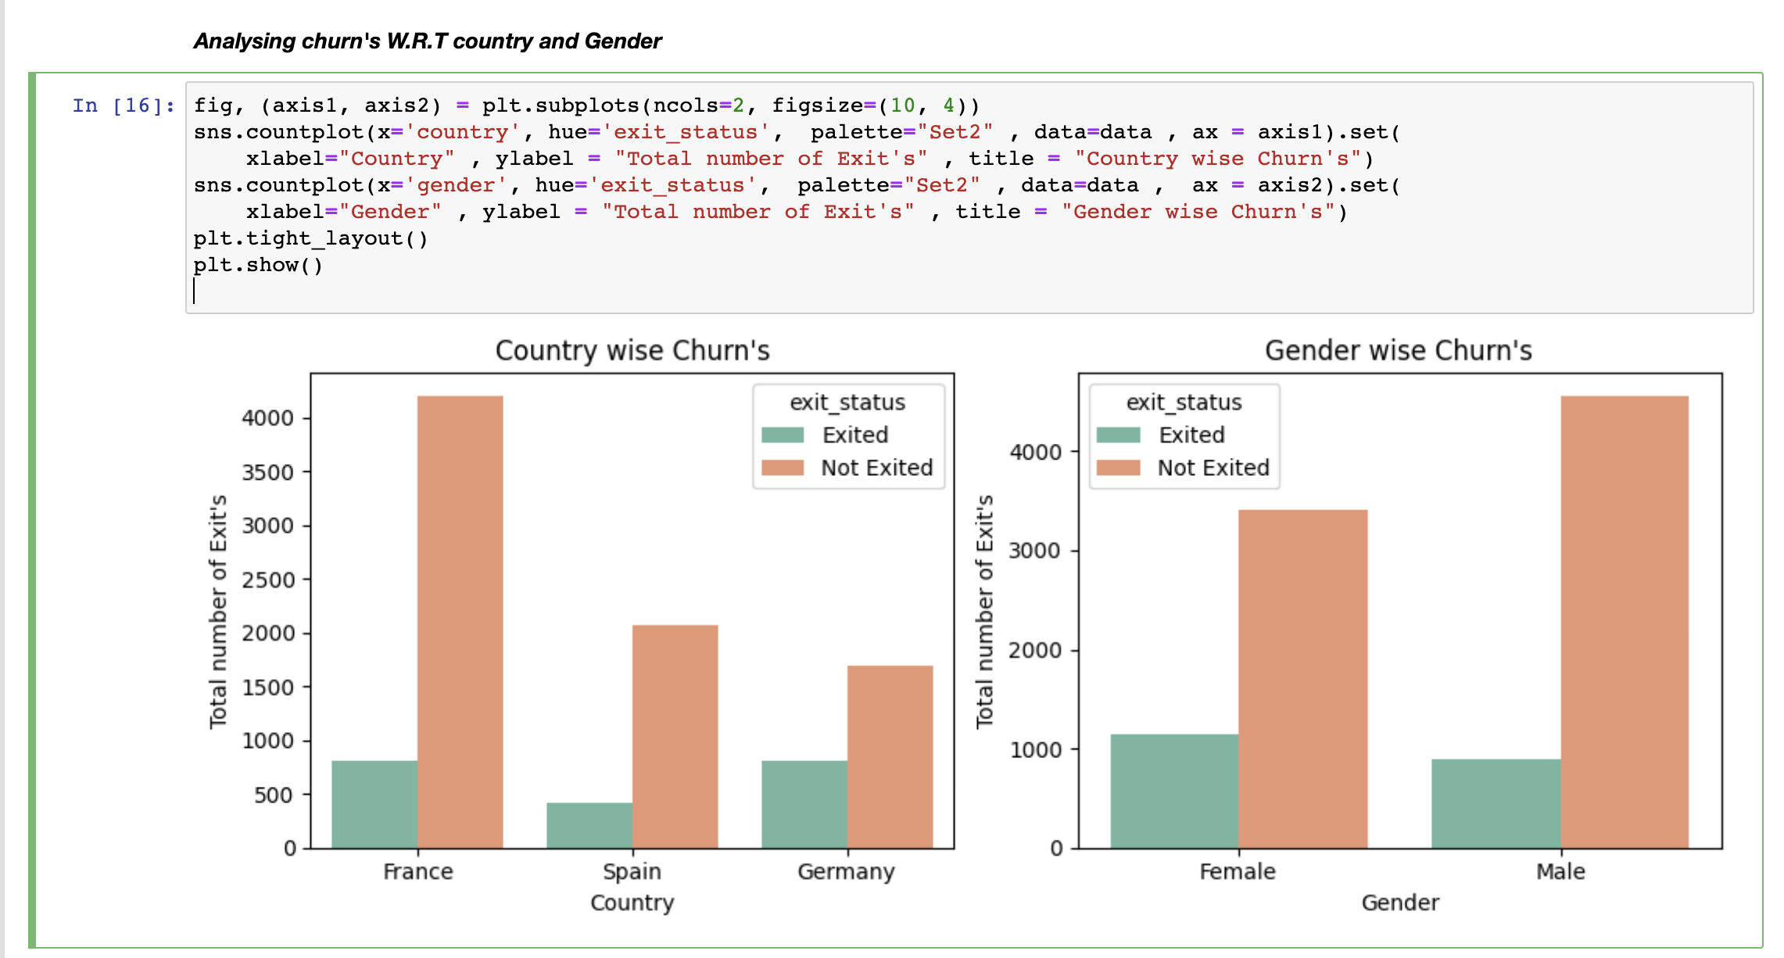
Visualizing Churn data w.r.t Country and Gender

Slide 12
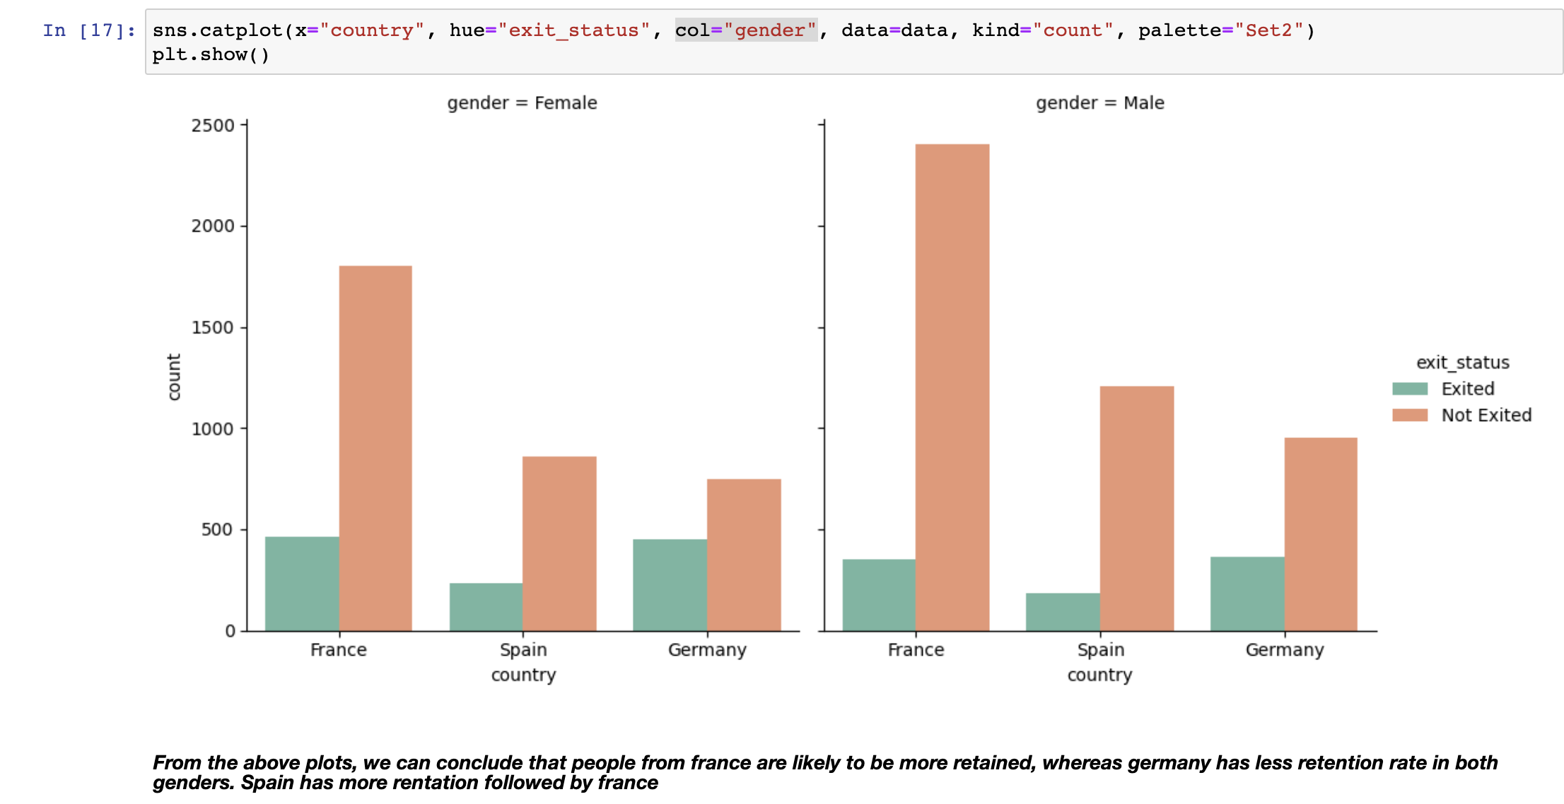
Visualizing Churn data w.r.t Country ( Gender wise )

Slide 13
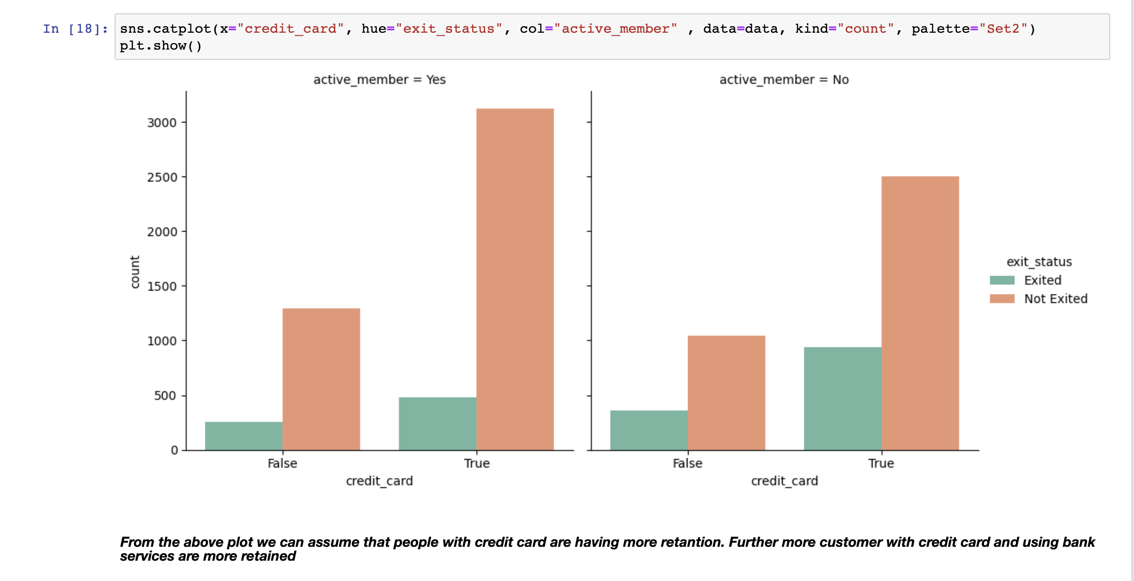
Visualizing Churn data w.r.t Credit card and active status

Slide 14
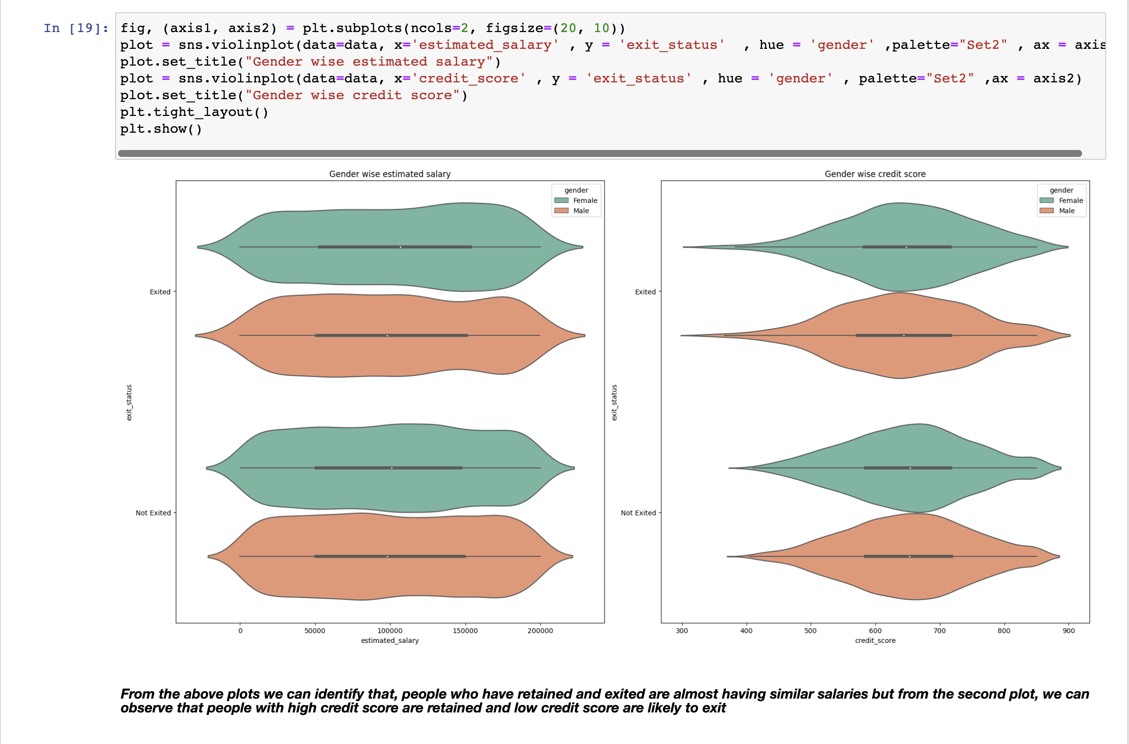
Visualizing Churn data w.r.t Credit score and Salary gender Wise

Slide 15
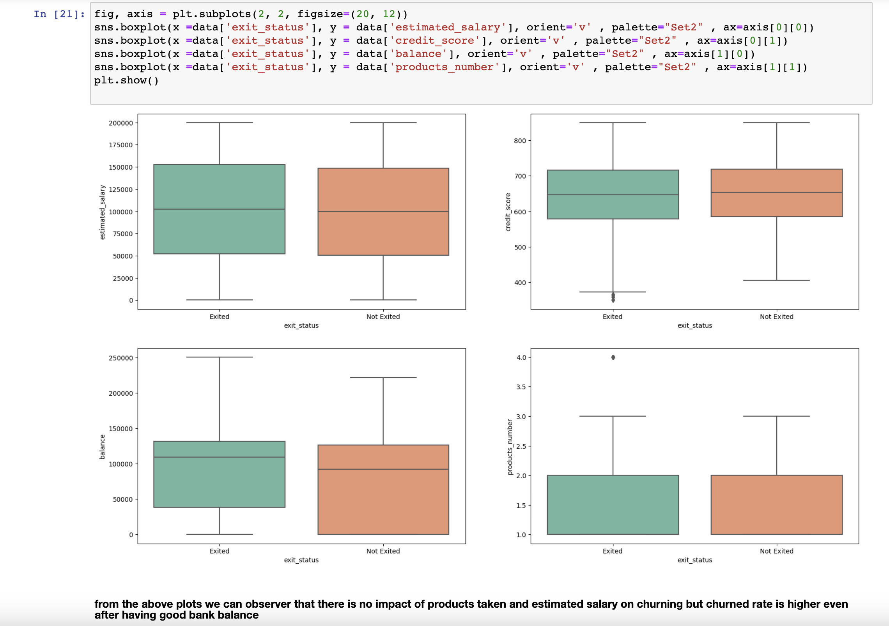
Visualizing Churn data w.r.t Salary, Credit score , Balance, Products to identify reasons for churn.

Slide 16
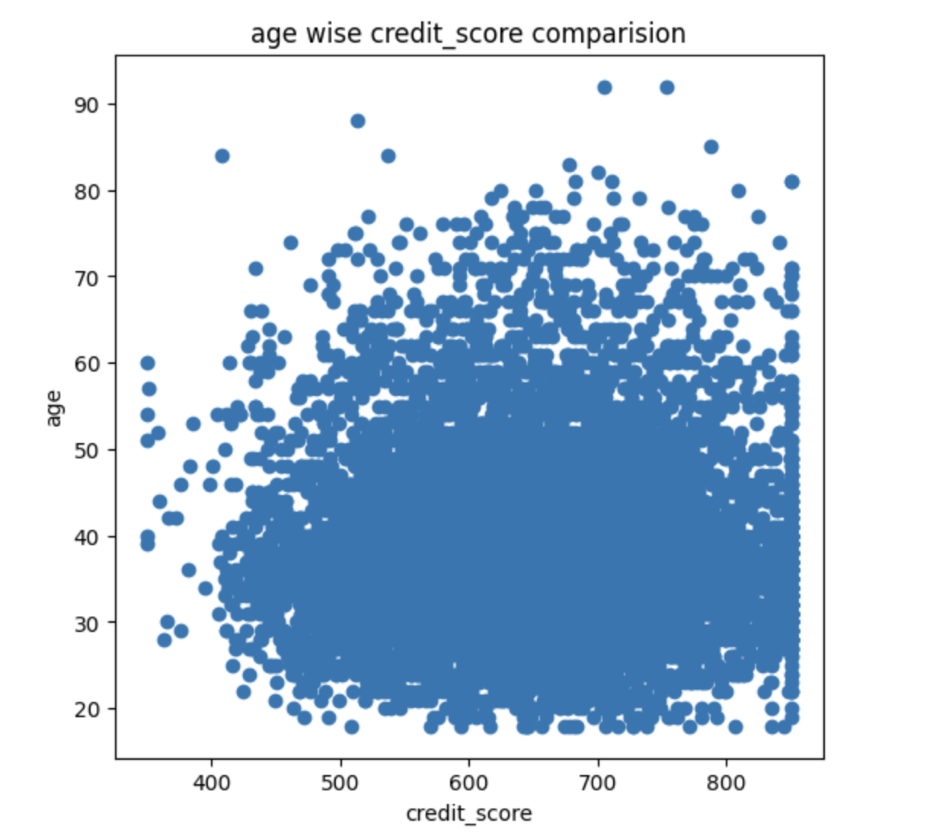
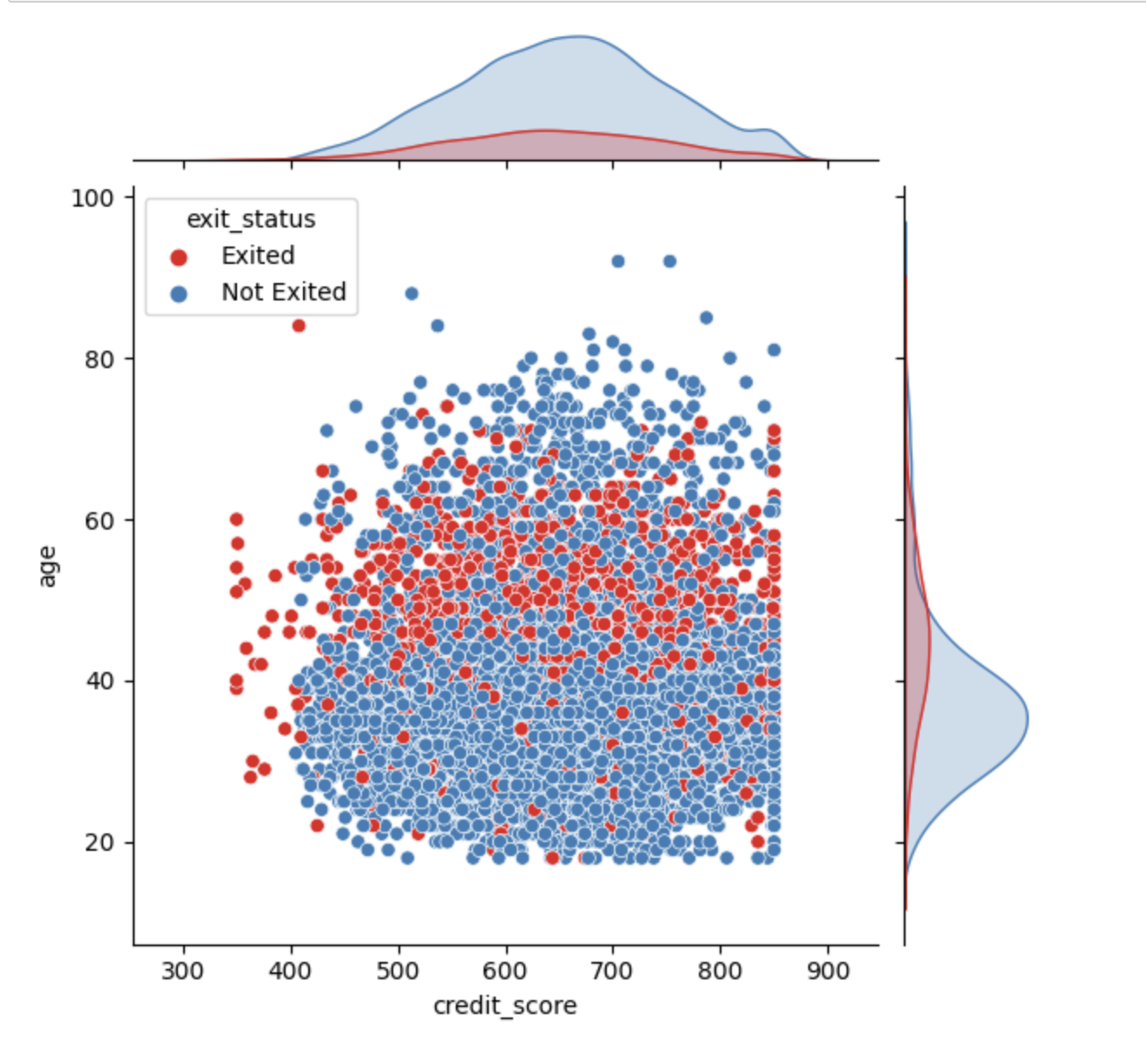
Visualizing Churn data w.r.t Age and Credit score

Slide 17
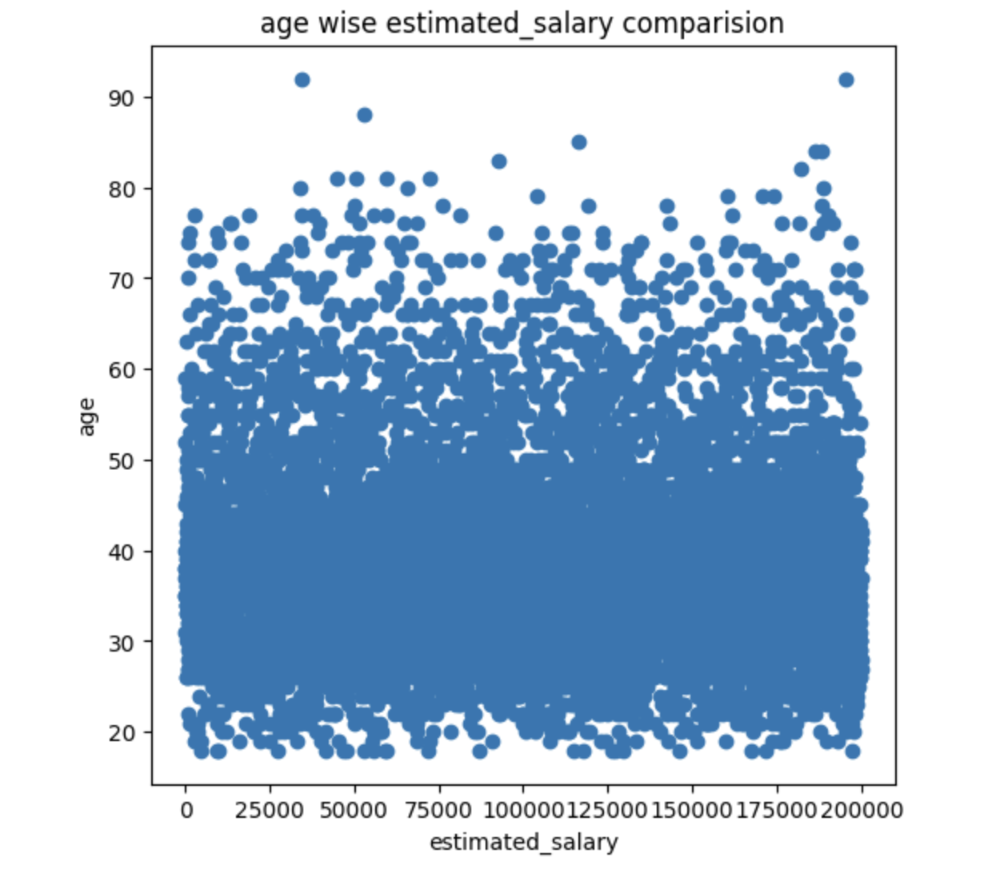
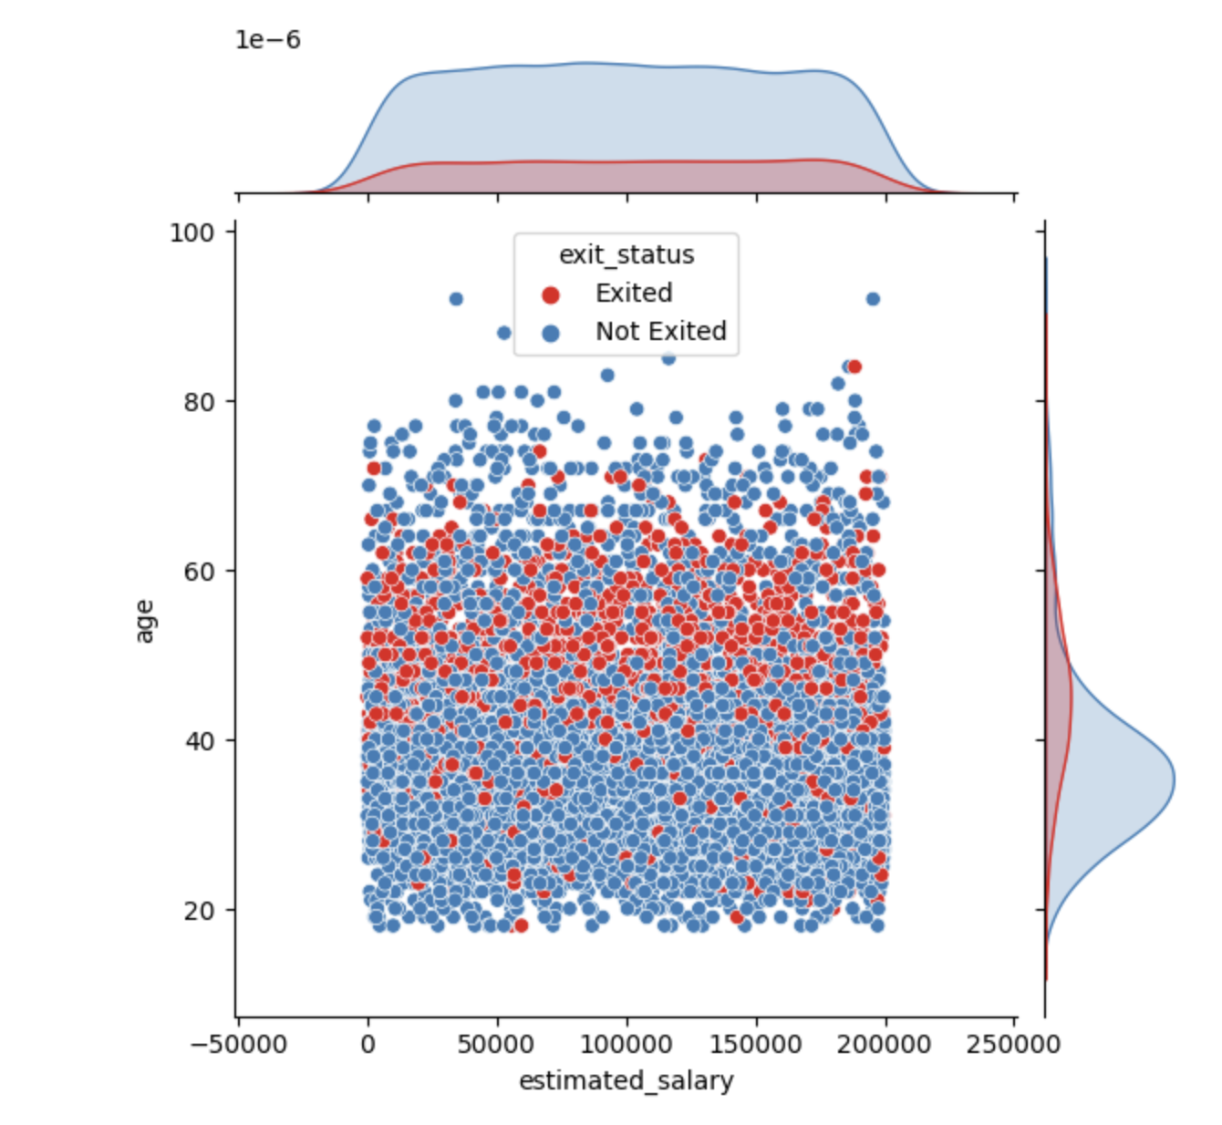
Visualizing Churn data w.r.t Age and Estimated salary

Slide 18
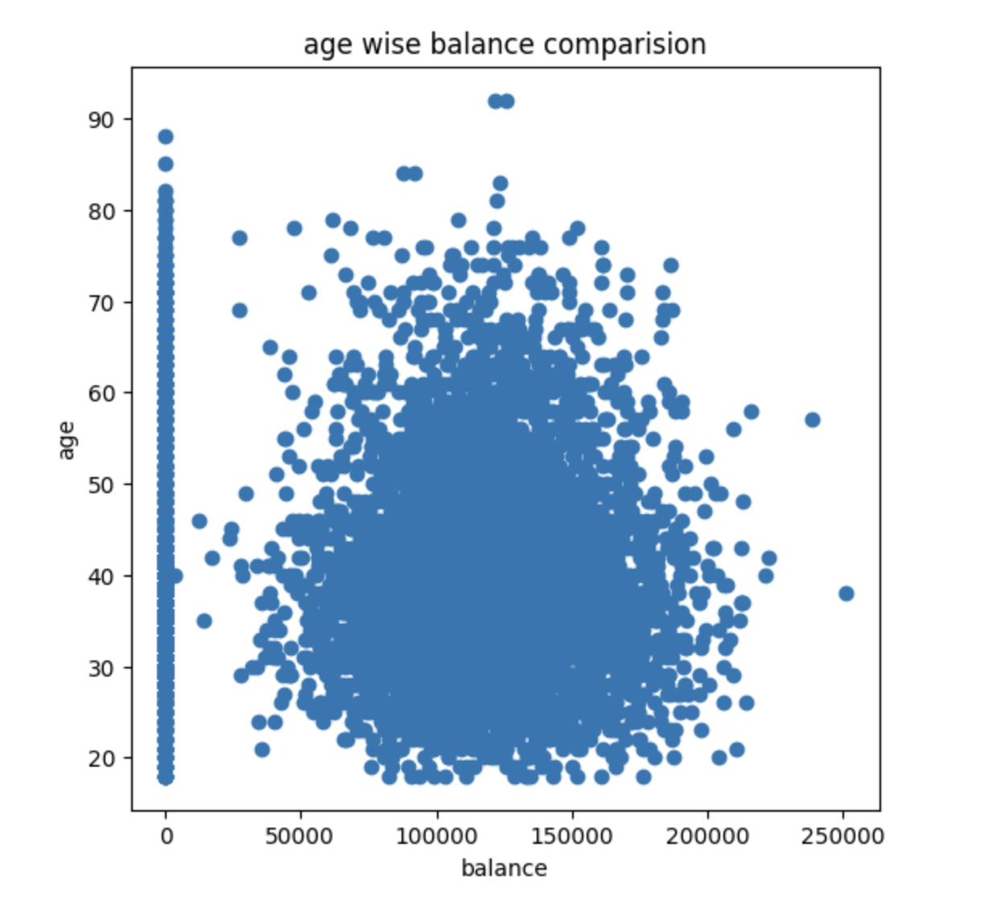
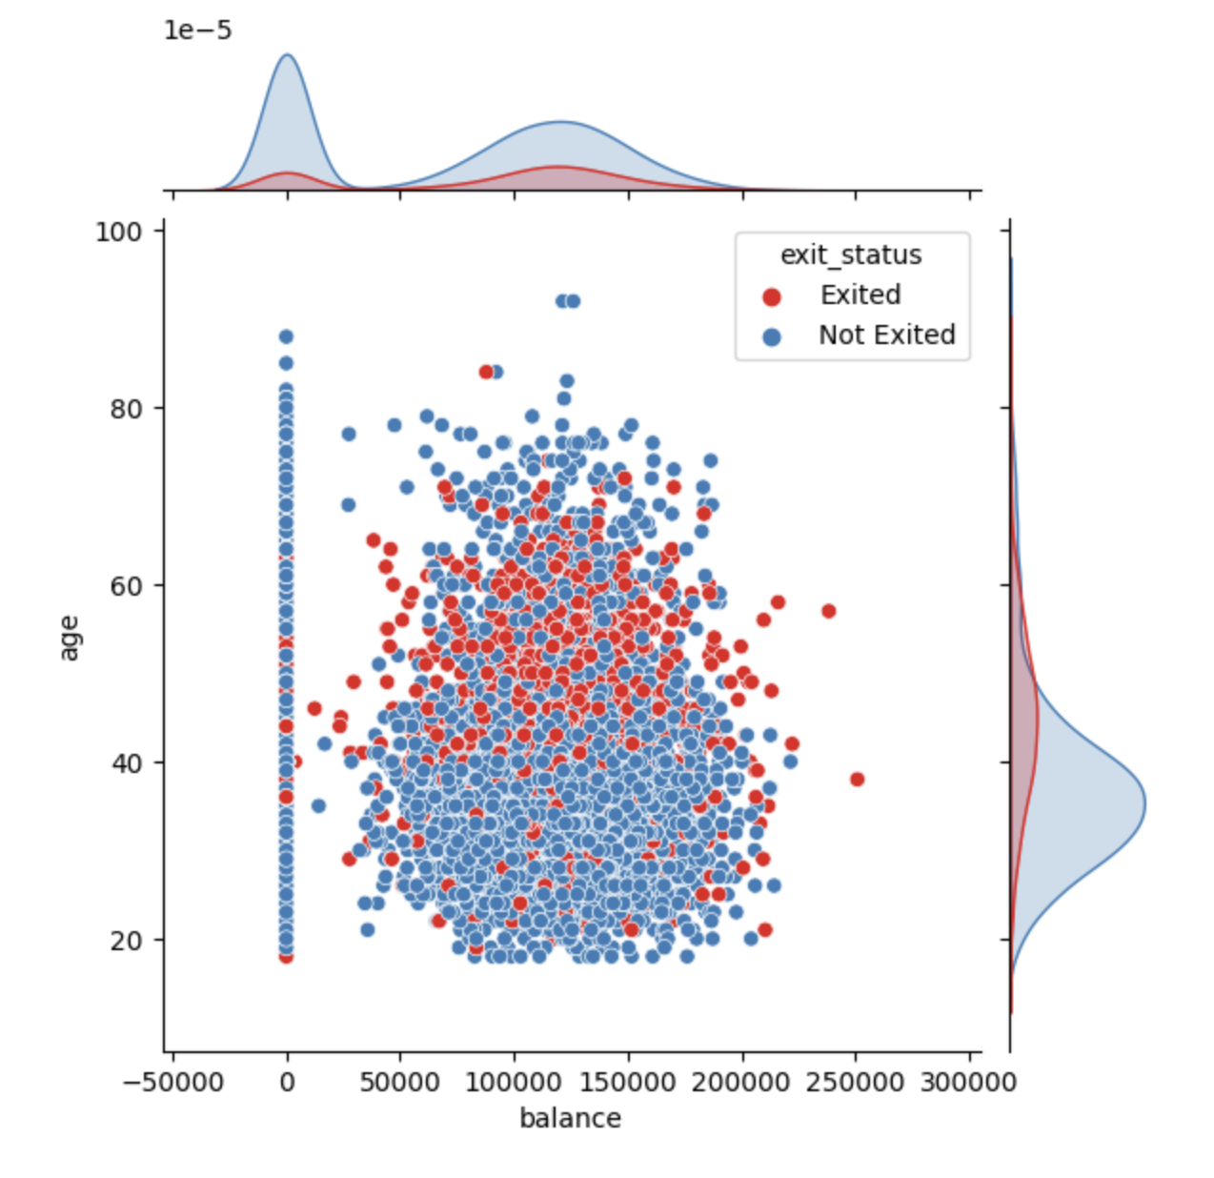
Visualizing Churn data w.r.t Age and Estimated salary

Slide 19
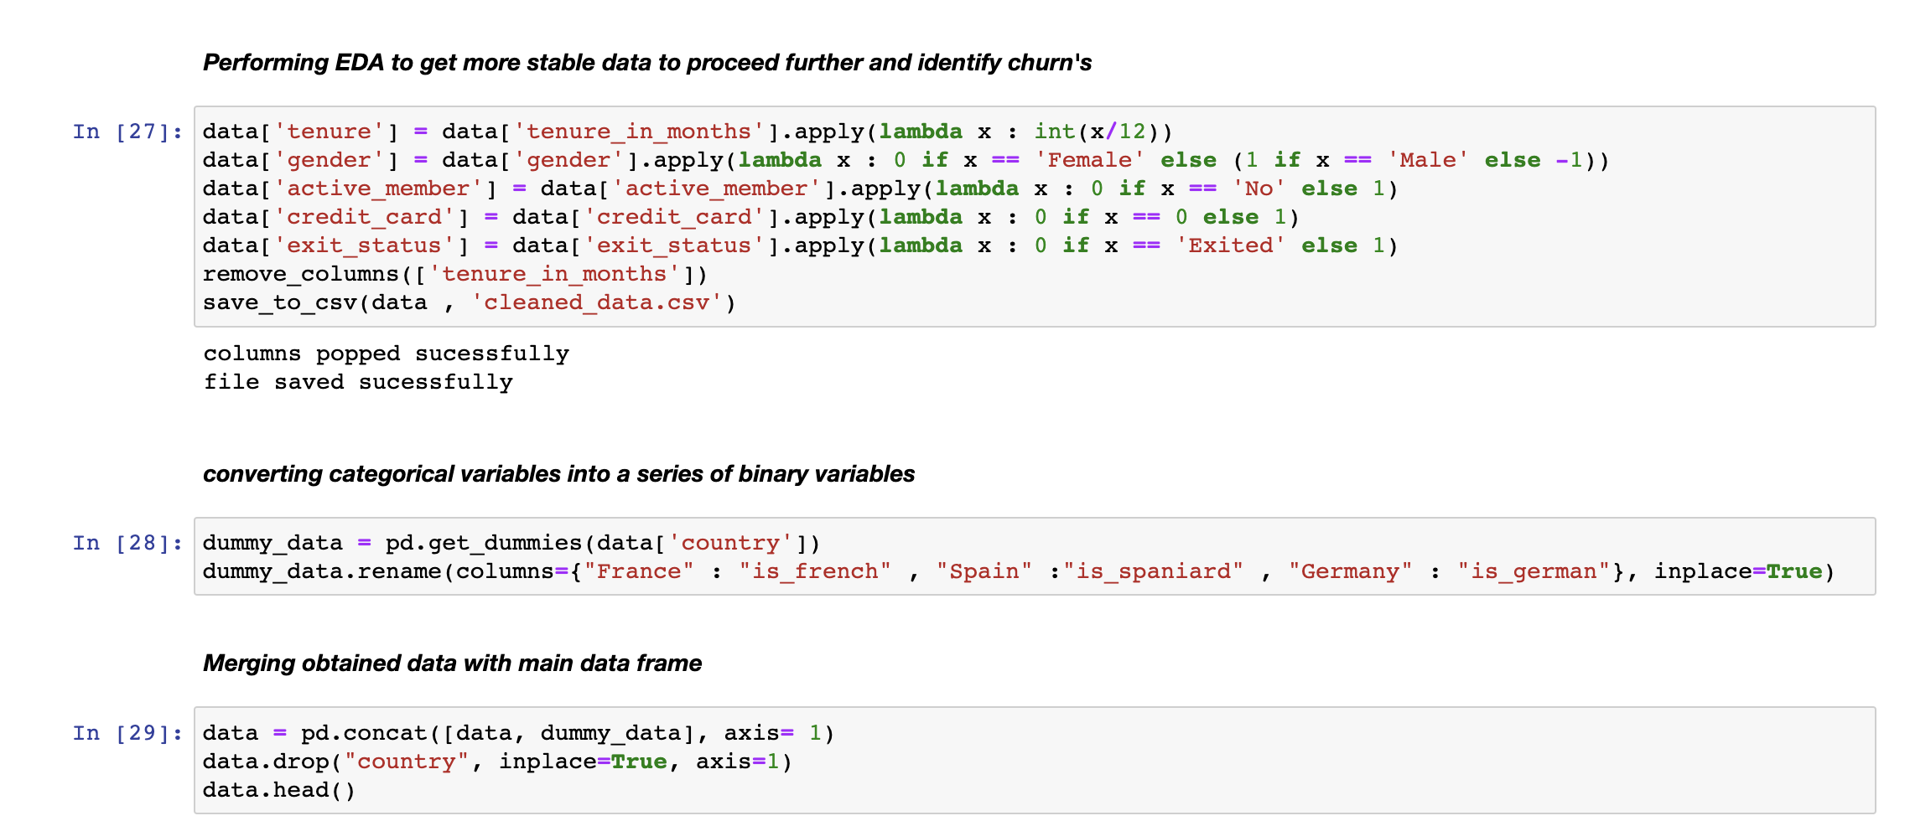
Altering columns to standardize the data and merging with main DF

Slide 20
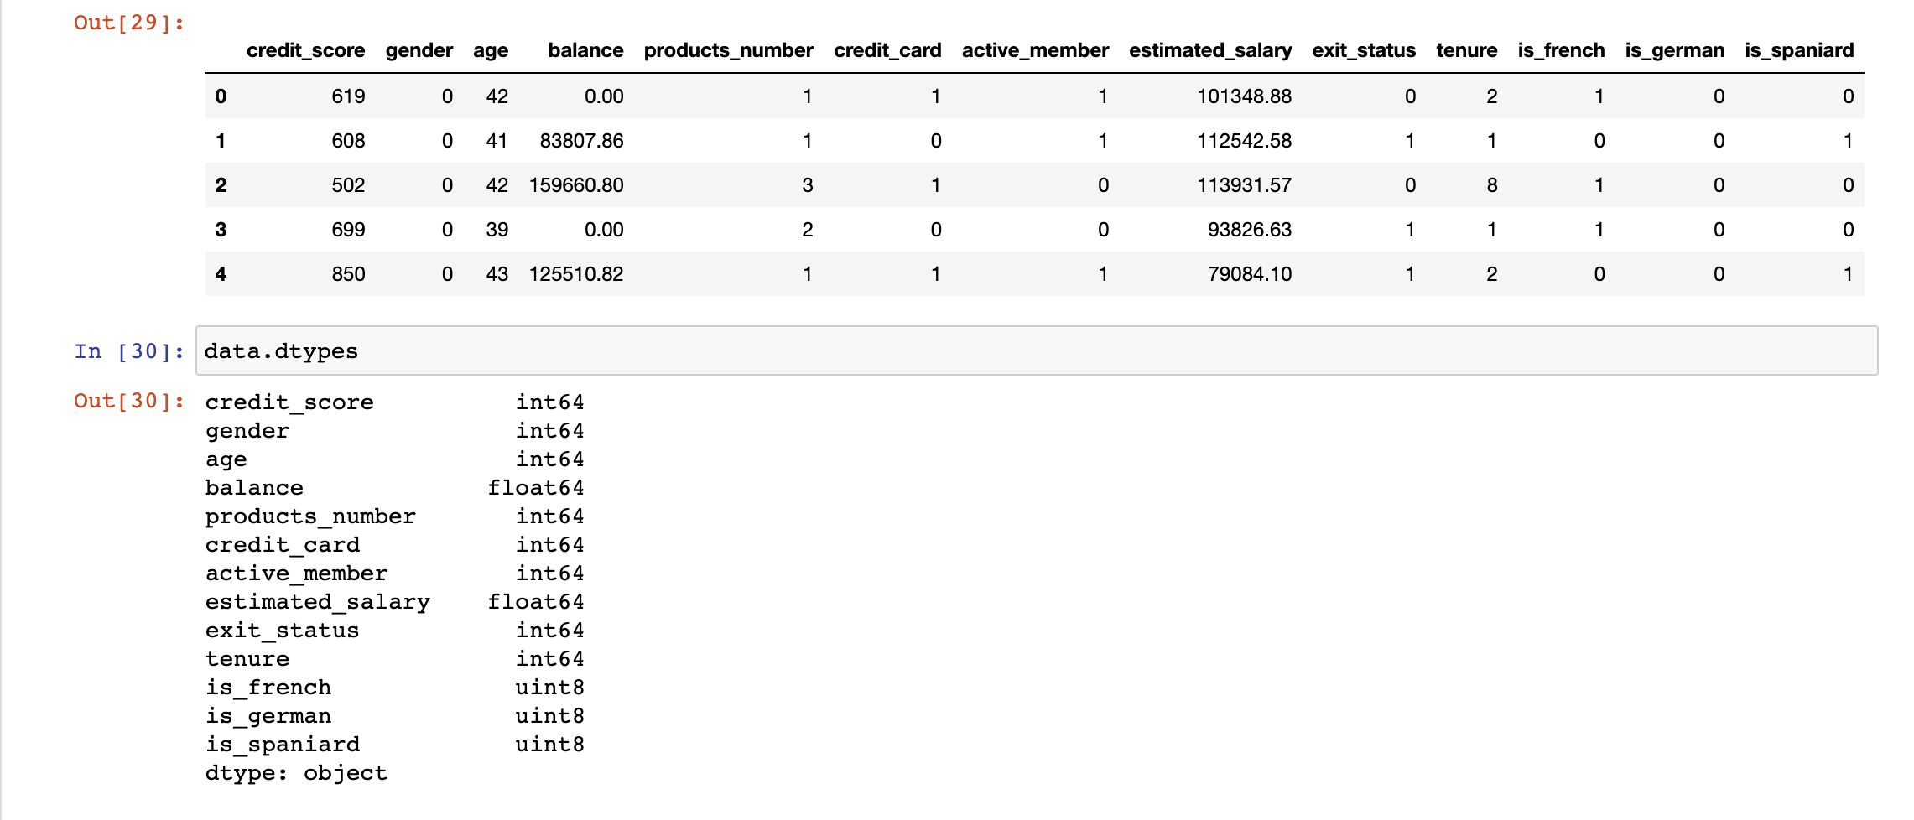
Displaying the data after Cleaning and checking column types

Slide 21
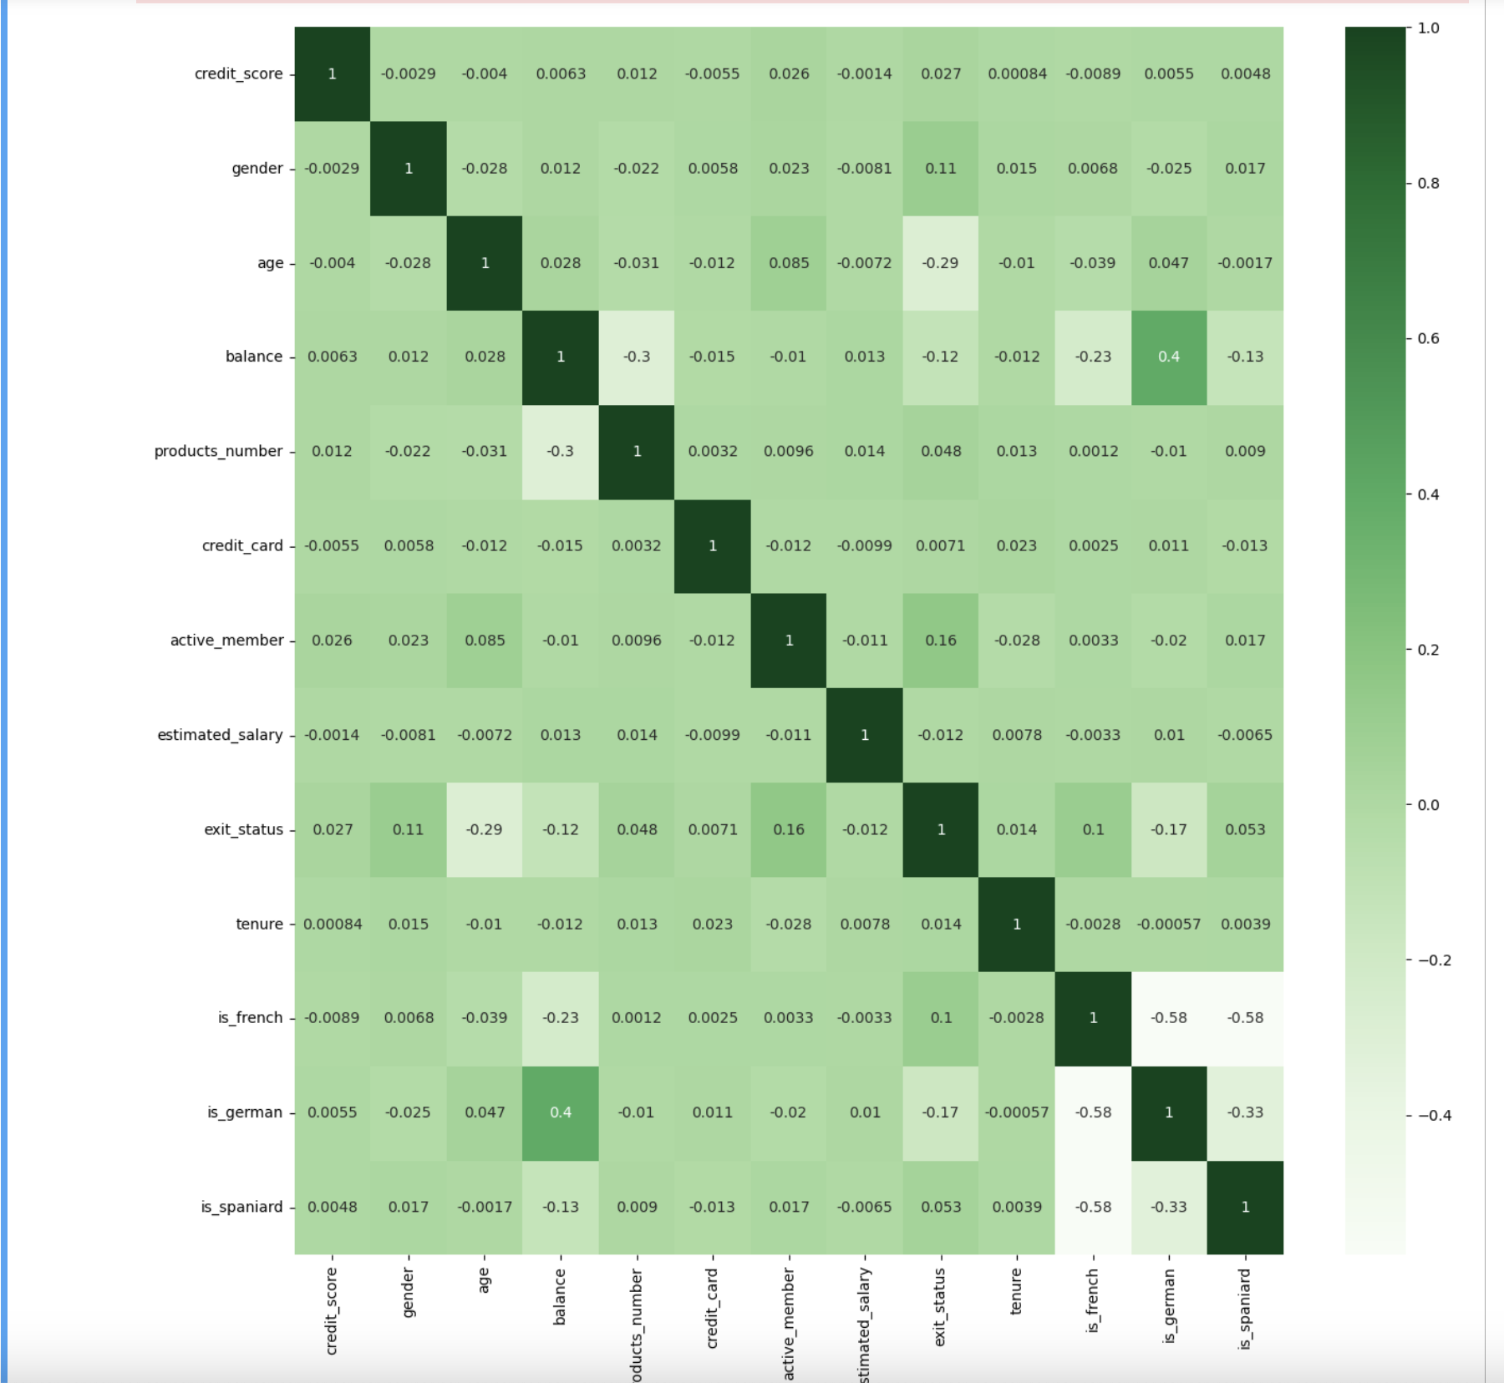
Plotting Heat map to identify the co-relation between all features

Slide 22
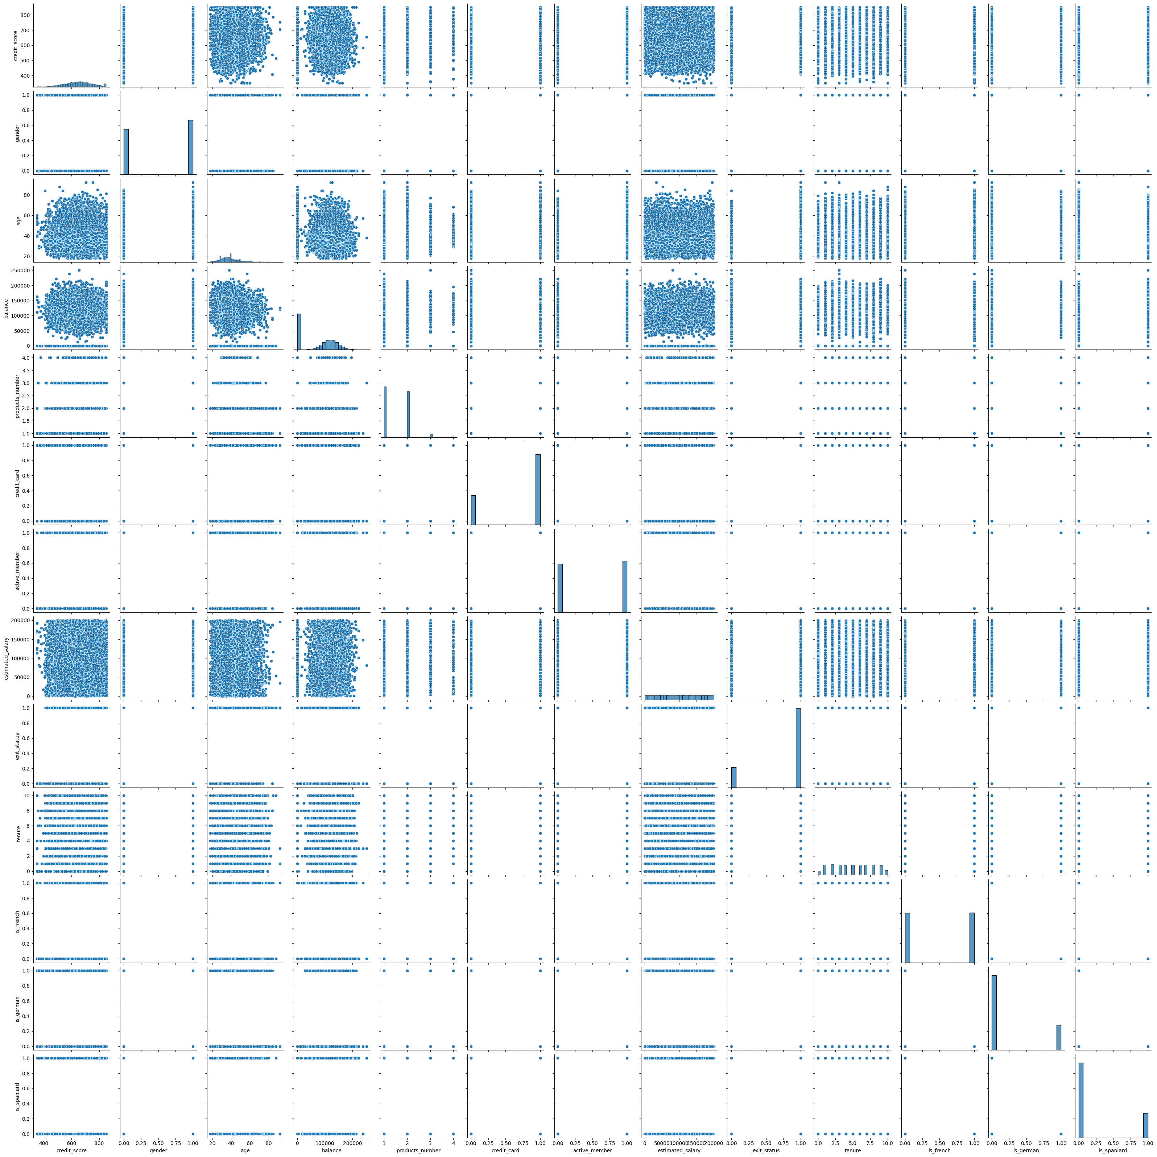
Plotting Pair Plot to identify the relation between all features

Slide 23
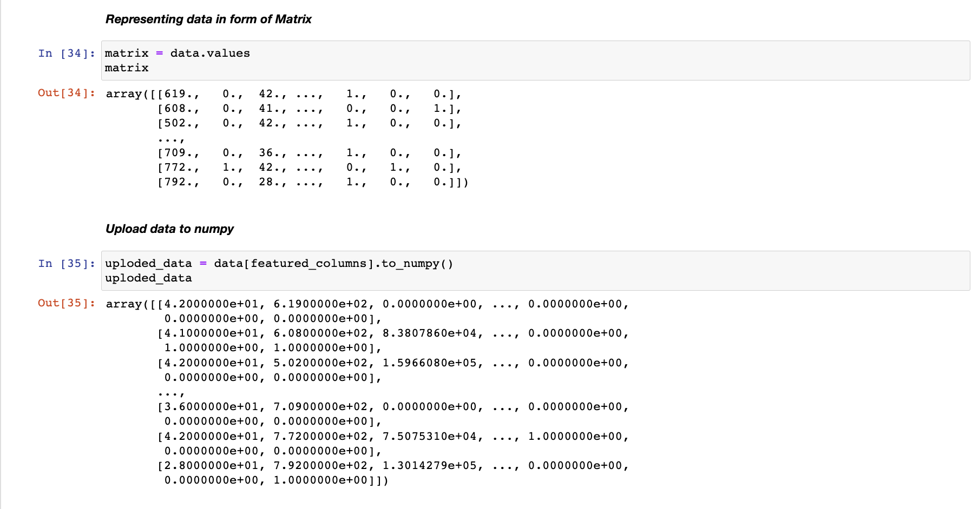
Representing data in form of Matrix and uploading to NumPy

Slide 24
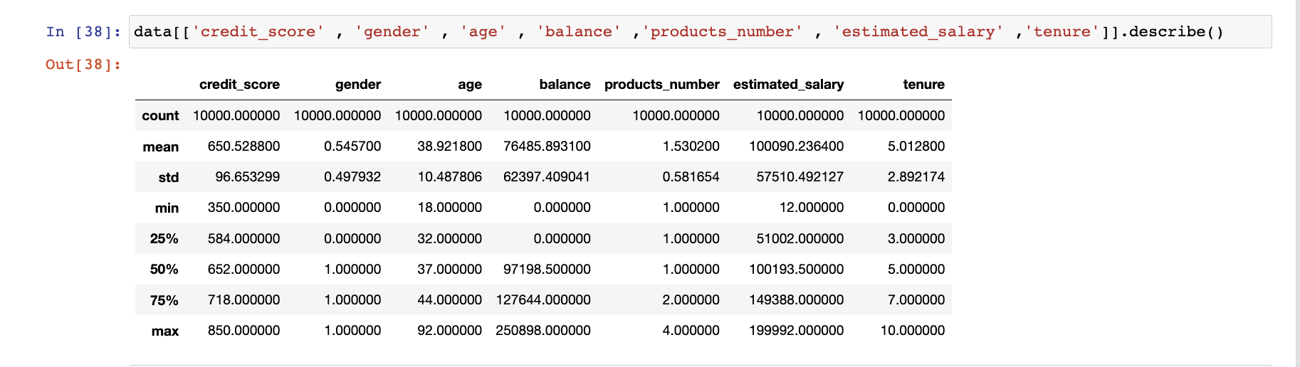
Describing data for all the features

Slide 25
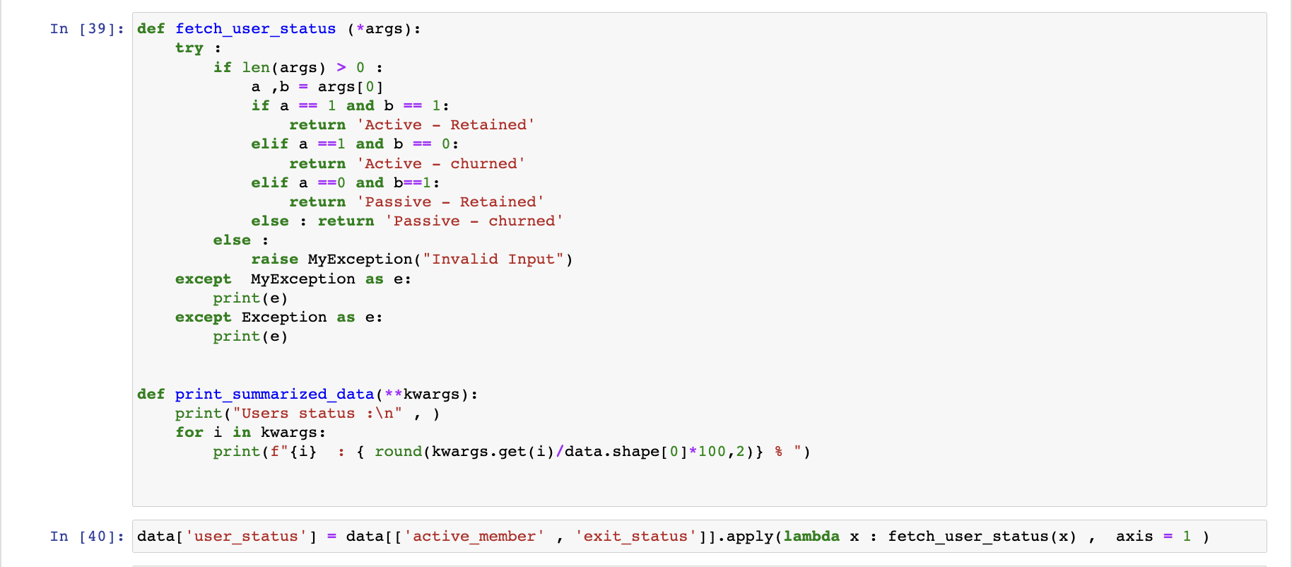
Categorizing the data based on Active and churn status

Slide 26
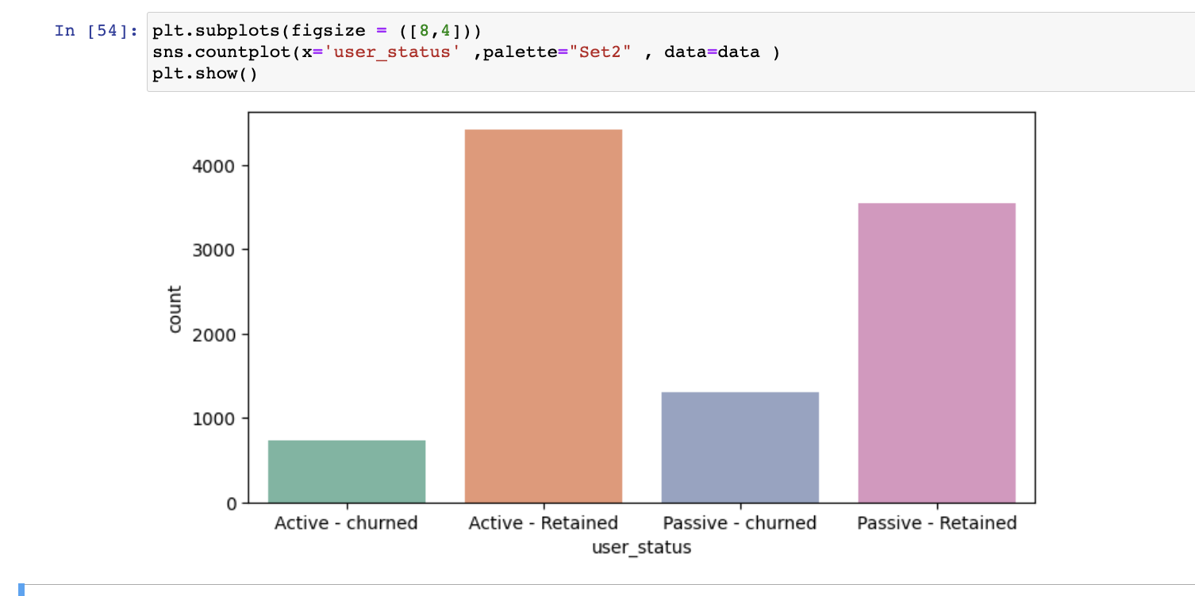
Reviewing the categorized data

Slide 27
Conclusions
From the above visualizations, we can conclude that people in the 40–60 age group are less likely to be retained.
People from France have better chances of being retained, followed by Spain and Germany, because the majority of bank customers are from France, increasing the possibility of providing good services. Moving forward, males have a higher retention rate as compared to females.
As per my observation, there is not much difference in credit scores between retained and churned customers, but people with good credit scores are more likely to be retained.
People who have credit cards are more hesitant. Customers who have credit cards and actively use bank services are more likely to be retained, according to research. Also, there is no impact of salary or product number on churning, and surprisingly, people with good bank balances are being churned.

